Slide 1
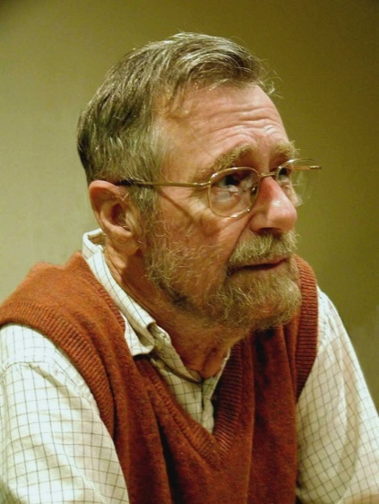
Dijkstra's Shortest Path
Programming – AI for Games

Slide 2
Contents
Why do we need the shortest path?
Graphs for Pathfinding
Breadth First Search review
Dijkstra’s Algorithm

Slide 3
Why do we need the shortest path?
Many systems need to find the shortest path between two nodes in a graph
Finding the shortest path between two locations
Finding the least number of moves needed to win a boardgame
Finding the most efficient set of steps to complete a task

Slide 4
Graphs For Pathfinding
One of the most common uses for graphs in games is pathfinding.
Being able to calculate how to get from point A to B in a game level.
Why not just move from A to B?
There could be obstacles or complex geometry blocking a straight line path between the two.

Slide 5
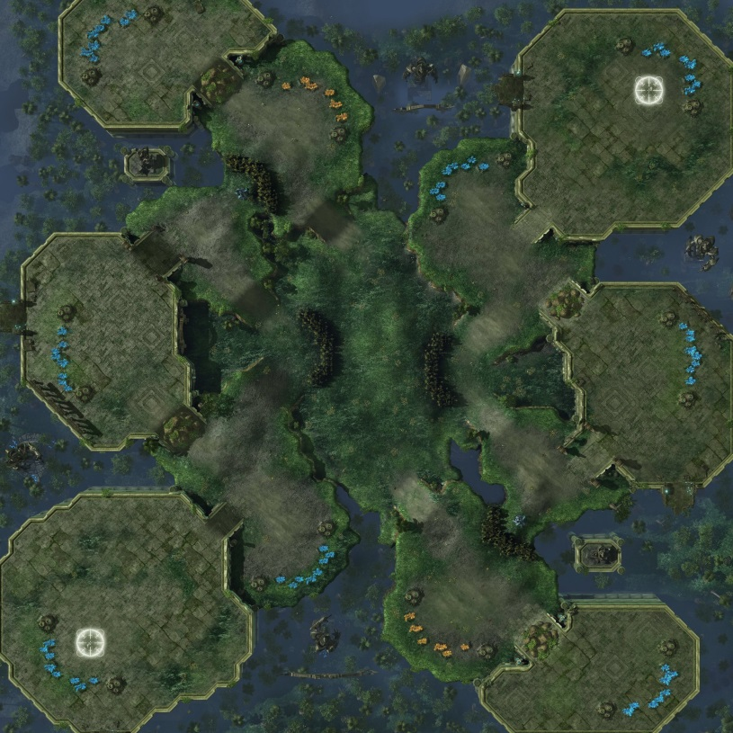
An Example
This is Steppes of War
A map in Starcraft 2

Slide 6
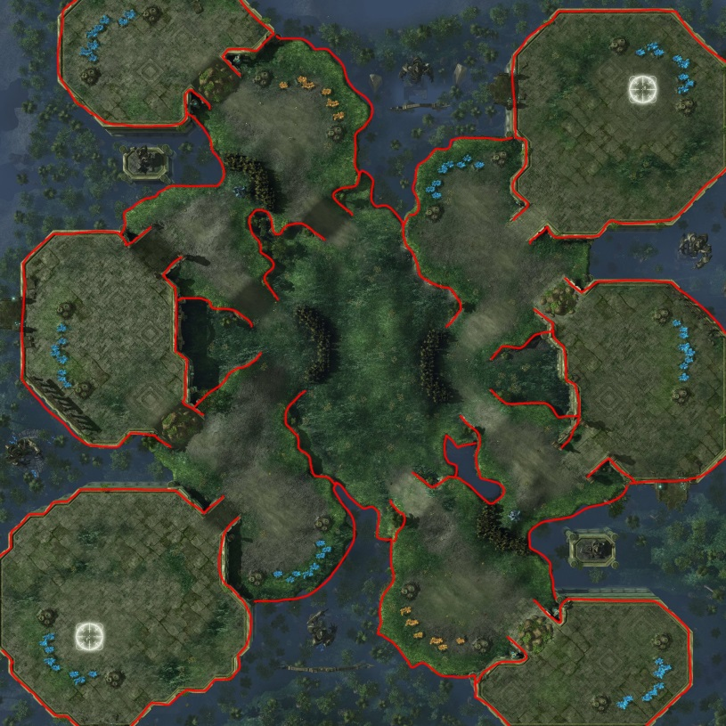
An Example
The walls are hard to see so we’ve highlighted them in red.

Slide 7
An Example
Lets say the player selected a unit here.

Slide 8
An Example
And told them to move over here.

Slide 9
An Example
If we just told the unit to move towards the goal.

Slide 10
An Example
It would run into the wall here.

Slide 11
An Example
The correct path looks more like this.

Slide 12
Graphs For Pathfinding
We solve the problem by filling the map with nodes.
Nodes represent a position and are only connected to another node if there is a straight line path between them.
To find the path, we now need to find the shortest path, along the edges from the starting node to the goal node.

Slide 13
Breadth First Search Review
Breadth First Search (BFS) fans out from the starting node in all directions until all connected nodes are processed.
Uses a queue to generate the order of the nodes it traverses.

Slide 14
Dijkstra’s Algorithm
Dijkstra’s Algorithm is a modification of Breadth-First-Search traversal, allowing us to find the shortest distance from any two nodes on a weighted graph.
For an unweighted graph, you can just treat all edges as having a weight of 1.
It makes two changes from vanilla BFS.
It adds a running count of the distance from the start to each node it traverses.
It uses a priority queue to pick the next node. This is a list sorted from smallest to largest.

Slide 15
Dijkstra’s Algorithm
Given this weighted graph, what paths can get us from node A to node E?
And from those paths which is the shortest?
Just looking at the graph, we can tell that there are 2 main options
2
A
B
3
3
5
C
1
4
F
D
6
4
E

Slide 16
Dijkstra’s Algorithm
The first path A->F->E costs a total of
5 + 6 = 11
2
A
B
3
3
5
C
1
4
F
D
6
4
E

Slide 17
Dijkstra’s Algorithm
The second path A->B->C->D->E costs
2+3+1+4 = 10
2
A
B
3
3
5
C
1
4
F
D
6
4
E

Slide 18
Dijkstra’s Algorithm
The first path A->F->E costs a total of
5 + 6 = 11
The second path A->B->C->D->E costs
2+3+1+4 = 10
So the second path is the fastest, even though it takes us through more nodes
2
A
B
3
3
5
C
1
4
F
D
6
4
E

Slide 19
Dijkstra’s Algorithm
So how do we get a computer to figure this out?
2
A
B
3
3
5
C
1
4
F
D
6
4
E

Slide 20
Dijkstra’s Algorithm
P
G
P
G
First we need to add two new pieces of information to each node.
The previous node we came from
The “G score”, or total traversal cost to get to this node
2
A
B
3
3
5
P
G
C
1
P
G
4
P
G
F
D
6
G
P
4
E

Slide 21
Open & Closed Lists
We call the priority queue the open list
It stores the nodes currently being processed
Sorted so the node with the lowest G-Score is first
We also have a closed list
Stores all the nodes already processed
This is so we don’t process the same node twice

Slide 22
Dijkstra’s Algorithm
-
0
2
-
0
A
B
Lets look at how the search works
We’re trying to get from Node A to Node E
3
3
5
-
0
C
1
-
0
4
-
0
F
D
6
0
-
4
E

Slide 23
Dijkstra’s Algorithm
-
0
2
-
0
A
B
We initialise our open list and closed list and add the start node (A) to the open list
Now we’re ready to start
3
3
5
-
0
C
1
-
0
4
-
0
F
D
Open List
Closed List
A
6
0
-
4
E

Slide 24
Dijkstra’s Algorithm
-
0
2
-
0
A
B
While the open list is not empty we repeat this process
Remove the first node from open list
It becomes the current node (highlighted)
3
3
5
-
0
C
1
-
0
4
-
0
F
D
Open List
Closed List
6
0
-
4
E

Slide 25
Dijkstra’s Algorithm
-
0
2
-
0
A
B
Add the current node to the closed list so we never process it again
3
3
5
-
0
C
1
-
0
4
-
0
F
D
Open List
Closed List
A
6
0
-
4
E

Slide 26
Dijkstra’s Algorithm
-
0
2
A
2
A
B
Calculate the G score of connected nodes
Current’s G score plus cost of the path
Set each node’s Previous to be the current node
3
3
5
-
0
C
1
A
5
4
-
0
F
D
Open List
Closed List
A
6
0
-
4
E

Slide 27
Dijkstra’s Algorithm
-
0
2
A
2
A
B
Add connected nodes to the open list
The open list is always sorted so B which has a lower G score is first
3
3
5
-
0
C
1
A
5
4
-
0
F
D
Open List
Closed List
B
F
A
6
0
-
4
E

Slide 28
Dijkstra’s Algorithm
-
0
2
A
2
A
B
Now we repeat
Remove the first node from the open list
Node B becomes the new current node
3
3
5
-
0
C
1
A
5
4
-
0
F
D
Open List
Closed List
F
A
6
0
-
4
E

Slide 29
Dijkstra’s Algorithm
-
0
2
A
2
A
B
Add the current node to the closed list
3
3
5
-
0
C
1
A
5
4
-
0
F
D
Open List
Closed List
F
A
B
6
0
-
4
E

Slide 30
Dijkstra’s Algorithm
-
0
2
A
2
A
B
Calculate the G score of connected nodes
Current’s G score plus cost of the path
Set each node’s Previous to be the current node
3
3
5
B
5
C
1
A
5
4
-
0
F
D
Open List
Closed List
F
A
B
6
0
-
4
E

Slide 31
Dijkstra’s Algorithm
-
0
2
A
2
A
B
Add connected nodes to the open list
When two nodes in the open list have the same G score, the order doesn’t change
3
3
5
B
5
C
1
A
5
4
-
0
F
D
Open List
Closed List
F
C
A
B
6
0
-
4
E

Slide 32
Dijkstra’s Algorithm
-
0
2
A
2
A
B
And repeat
Remove the first node from the open list
F will become the new current node
3
3
5
B
5
C
1
A
5
4
-
0
F
D
Open List
Closed List
C
A
B
6
0
-
4
E

Slide 33
Dijkstra’s Algorithm
-
0
2
A
2
A
B
Add the current node to the closed list
3
3
5
B
5
C
1
A
5
4
-
0
F
D
Open List
Closed List
C
A
B
F
6
0
-
4
E

Slide 34
Dijkstra’s Algorithm
-
0
2
A
2
A
B
Calculate the G score of connected nodes
Current’s G score plus cost of the path
Set each node’s Previous to be the current node
3
3
5
B
5
C
1
A
5
4
-
0
F
D
Open List
Closed List
C
A
B
F
6
11
F
4
E

Slide 35
Dijkstra’s Algorithm
-
0
2
A
2
A
B
Add connected nodes to the open list
We’ve added node E, our destination to the open list, but we’re not done yet
If we stopped now, it wouldn’t be the shorted path
3
3
5
B
5
C
1
A
5
4
-
0
F
D
Open List
Closed List
C
E
A
B
F
6
11
F
4
E

Slide 36
Dijkstra’s Algorithm
-
0
2
A
2
A
B
And repeat
Remove the first node from the open list
C will become the new current node
3
3
5
B
5
C
1
A
5
4
-
0
F
D
Open List
Closed List
E
A
B
F
6
11
F
4
E

Slide 37
Dijkstra’s Algorithm
-
0
2
A
2
A
B
Add the current node to the closed list
3
3
5
B
5
C
1
A
5
4
-
0
F
D
Open List
Closed List
E
A
B
F
6
11
F
4
E
C

Slide 38
Dijkstra’s Algorithm
-
0
2
A
2
A
B
Calculate the G score of connected nodes
Current’s G score plus cost of the path
Set each node’s Previous to be the current node
3
3
5
B
5
C
1
A
5
4
C
6
F
D
Open List
Closed List
E
A
B
F
6
11
F
4
E
C

Slide 39
Dijkstra’s Algorithm
-
0
2
A
2
A
B
Add connected nodes to the open list
Node D has a lower score than E so it gets sorted to the start of the open list
There is also a connection to Node A, but it’s already in the closed list so we ignore it
3
3
5
B
5
C
1
A
5
4
C
6
F
D
Open List
Closed List
D
E
A
B
F
6
11
F
4
E
C

Slide 40
Dijkstra’s Algorithm
-
0
2
A
2
A
B
And repeat
Remove the first node from the open list
D will become the new current node
3
3
5
B
5
C
1
A
5
4
C
6
F
D
Open List
Closed List
E
A
B
F
6
11
F
4
E
C

Slide 41
Dijkstra’s Algorithm
-
0
2
A
2
A
B
Add the current node to the closed list
3
3
5
B
5
C
1
A
5
4
C
6
F
D
Open List
Closed List
E
A
B
F
6
11
F
4
E
C
D

Slide 42
Dijkstra’s Algorithm
-
0
2
A
2
A
B
Calculate the G score and Previous of connected nodes
Node F is already in the closed list so ignore it.
Node E is in the open list… what happens?
3
3
5
B
5
C
1
A
5
4
C
6
F
D
Open List
Closed List
E
A
B
F
6
11
F
4
E
C
D

Slide 43
Dijkstra’s Algorithm
-
0
2
A
2
A
B
If this new path is better, we update the node’s G score and Previous
Node E currently has a score of 11
Node D’s 6 plus the path cost of 4 equals 10
This new path is cheaper!
3
3
5
B
5
C
1
A
5
4
C
6
F
D
Open List
Closed List
E
A
B
F
6
11
F
4
E
C
D

Slide 44
Dijkstra’s Algorithm
-
0
2
A
2
A
B
Replace Node E’s score and Previous with the new, cheaper values
If the path were more expensive, we’d do nothing
3
3
5
B
5
C
1
A
5
4
C
6
F
D
Open List
Closed List
E
A
B
F
6
10
D
4
E
C
D

Slide 45
Dijkstra’s Algorithm
-
0
2
A
2
A
B
Add the connected nodes to the open list…
Node F is already in the closed list so we ignore it
Node E is already in the open list, we don’t add it again
So nothing happens
3
3
5
B
5
C
1
A
5
4
C
6
F
D
Open List
Closed List
E
A
B
F
6
10
D
4
E
C
D

Slide 46
Dijkstra’s Algorithm
-
0
2
A
2
A
B
And repeat… one last time
Remove the first node from the open list
E will become the new current node
3
3
5
B
5
C
1
A
5
4
C
6
F
D
Open List
Closed List
A
B
F
6
10
D
4
E
C
D

Slide 47
Dijkstra’s Algorithm
-
0
2
A
2
A
B
Add the current node to the closed list
3
3
5
B
5
C
1
A
5
4
C
6
F
D
Open List
Closed List
A
B
F
6
10
D
4
E
C
D
E

Slide 48
Dijkstra’s Algorithm
-
0
2
A
2
A
B
And Stop!
The moment the destination is added to the closed list, we have found our shortest path
3
3
5
B
5
C
1
A
5
4
C
6
F
D
Open List
Closed List
A
B
F
6
10
D
4
E
C
D
E

Slide 49
Dijkstra’s Algorithm
-
0
2
A
2
A
B
Starting with the destination (E), we follow the Previous Node variable back to find the path
3
3
5
B
5
C
1
A
5
4
C
6
F
D
Open List
Closed List
A
B
F
6
10
D
4
E
C
D
E

Slide 50
Dijkstra’s Algorithm
-
0
2
A
2
A
B
Starting with the destination (E), we follow the Previous Node variable back to find the path
3
3
5
B
5
C
1
A
5
4
C
6
F
D
Open List
Closed List
A
B
F
6
10
D
4
E
C
D
E

Slide 51
Dijkstra’s Algorithm
-
0
2
A
2
A
B
Starting with the destination (E), we follow the Previous Node variable back to find the path
3
3
5
B
5
C
1
A
5
4
C
6
F
D
Open List
Closed List
A
B
F
6
10
D
4
E
C
D
E

Slide 52
Dijkstra’s Algorithm
-
0
2
A
2
A
B
Starting with the destination (E), we follow the Previous Node variable back to find the path
3
3
5
B
5
C
1
A
5
4
C
6
F
D
Open List
Closed List
A
B
F
6
10
D
4
E
C
D
E

Slide 53
Dijkstra’s Algorithm
-
0
2
A
2
A
B
Starting with the destination (E), we follow the Previous Node variable back to find the path
3
3
5
B
5
C
1
A
5
4
C
6
F
D
Open List
Closed List
A
B
F
6
10
D
4
E
C
D
E

Slide 54
Dijkstra’s Algorithm
-
0
2
A
2
A
B
That gives us E->D->C->B->A
If we reverse this list we get
A->B->C->D->E
The shortest path!
3
3
5
B
5
C
1
A
5
4
C
6
F
D
Open List
Closed List
A
B
F
6
10
D
4
E
C
D
E

Slide 55
Dijkstra’s Algorithm - Optimisations
Dijkstra’s calculates the shortest path from the start node to every other node in the graph.
This means for small graphs, we could just pre-calculate Dijkstra’s for every node and we would know the shortest path from every node to every other node.
For anything other than small graphs, this takes a prohibitively large amount of memory to store all the results.
It also means you can’t dynamically change the map, or the weights without recalculating every node again.
Dijkstra’s is also quite expensive to run for larger graphs.
To solve all of these problems we turn to a new algorithm, called A*

Slide 56
Summary
Pathfinding is one of the most common applications for shortest path algorithms
Needed to navigate obstacles or complex geometry
For pathfinding to work, we first build a graph of nodes
Dijkstra’s algorithm uses a modified BFS
Dijkstra’s will find the shortest path to every other node in the graph
Is expensive to run for larger graphs

Slide 57
References
Ian Millington, 2009. Artificial Intelligence for Games. 2 Edition. CRC Press.

